Slide 1
Car Rental system
Project management
Professor : Somesh Rao Pullapantula

Slide 2



Team Members
Ba Luan Tran
(SR. Java Software Engineer)
Hesham Al Zoubi
(Java Backend Developer)
Kevin Kinuthia
(Frontend Developer)

Slide 3
AGENDA
Project Network Diagram
Project Business Goals
Lessons Learned
Amount Of Scope Not Covered
WBS Changes and Risk Encountered
Science of Technology and Consciousness Principles connecting to project
Q/A

Slide 4
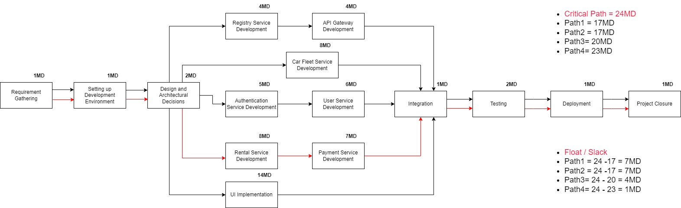
Project Network Diagram
W1
Scope Finalization

Slide 5
Business Goals
Introducing an online car rental platform for effortless vehicle leasing. It allows rental companies to manage their fleet and staff while offering users flexible registration options. Plus, with a secure payment gateway, customers can easily book using major credit cards like Visa and Master Card.

Slide 6
Business Process Overview
The system offers a tailored login, directing users based on their role. Employees receive tools for fleet management and maintenance, while customers, regular or frequent, can easily browse, reserve, and securely pay for vehicle bookings.

Slide 7
Lessons Learned
Importance of Planning:
Scope Definition: Clearly defining what's in (and out) of the project's scope to prevent scope creep.
Time Management: Estimating how long activities will take and scheduling them appropriately.
Risk Management:
Identifying potential risks early on.
Developing strategies to mitigate or respond to these risks.

Slide 8
Lessons Learned
Effective Communication:
The importance of clear communication among team members.
Using the right communication tools and techniques for different situations.
Team Dynamics:
Understanding team roles and responsibilities.
Promoting a positive team environment and managing conflicts.

Slide 9
Lessons Learned
Value of Continuous Learning:
Recognizing that project management is an evolving field.
The importance of staying updated with the latest best practices and methodologies.

Slide 10
Limitation and Risk
Using New Technologies: New technologies can impact your project if you don't know how to use them efficiently.
Human Resource Management: You need to make sure that the team you have (Number, knowledge.) can handle the project requirements.
Time Management: Learning new technologies and techniques in a short time is hard to handle during a rapid project progress.

Slide 11
Amount Of Scope Not Covered
Car Fleet Service
task | Status | Note
Add Car | Done
Remove Car | Done
Update Car along with status (available, reserved, picked, under-maintenance) | Done
Status update upon car reservation (Kafka). | Done
Search Car (A filter search for cars based on the model, make, base cost (per day)) | Done

Slide 12
Amount Of Scope Not Covered
Car Fleet Service
task | Status | Note
View/Fetch car information | Done
Get car rental history. | Done
Get car maintenance history. | Done
Product monthly, quarterly, and annual car rental reports. | Done
Export monthly, quarterly, and annual car rental reports | Done

Slide 13
Amount Of Scope Not Covered
Rental Service
task | Status | Note
Get all cars | Done
Search Car (A filter search for cars based on the model, make, and base cost (per day)) | Done
Reserve a car (Send Kafka message to car fleet) | Done
Pick up a car (Send Kafka message to car fleet) | Done
Return a car (Payment included, Send Kafka message to car fleet). | Done

Slide 14
Amount Of Scope Not Covered
Rental Service
task | Status | Note
Process Payment | Done
Fetch/View customer rental history | Done

Slide 15
Amount Of Scope Not Covered
Customer/User Service
task | Status | Note
Add manager (Admin). | Done
Get customer car rental history (Manager). | Done
Disable customer account (Manager). | Done
Current Reservations (Customer) | Done
Rental History (Customer) | Done

Slide 16
Amount Of Scope Not Covered
Customer/User Service
task | Status | Note
Login (JWT) | Done
Register | Done

Slide 17
Amount Of Scope Not Covered
Non-Functional Requirements
task | Status | Note
Explicit Transaction management | Done
Add logging (console and file) to this application at different logging levels. | Done | Some services used console only for logging
Configure in application.properties the maximum number of cars a customer can reserve. | Done
Test all API endpoints with RestAssured. | Done

Slide 18
Amount Of Scope Not Covered
Non-Functional Requirements
task | Status | Note
Make proper use of all the relevant knowledge you have gained in all the courses. | Done
Make proper use of algorithms, problem-solving techniques, Java Collections, Streams, Parallel Streams, Synchronization, Multi-threading (Runnable, Callable, Thread, Executor Framework, CompletableFuture), and design patterns. | Done | Not all The mentioned techniques used Integrate between front-end and back-end

Slide 19
Setting Up & Running the React Application
Prerequisites:
A computer: This guide assumes you're using either Windows, MacOS, or Linux.
Steps:
1. Installing Necessary Software
Install Node.js:
Go to the Node.js website: https://nodejs.org
Download the LTS (Long Term Support) version.
Follow the installation instructions and complete the installation process.
Install Visual Studio Code (VS Code):
Go to the VS Code website: https://code.visualstudio.com/
Download the version appropriate for your operating system (Windows, MacOS, Linux).
Follow the installation instructions and complete the installation process.

Slide 20
Setting Up & Running the React Application
Steps:
2. Setting Up the Project
Download/Clone the React Application:
If the project is shared with you as a zip file, unzip it in a location you prefer.
Open the Project in VS Code:
Open VS Code.
Go to File > Open Folder (or similar menu options) and navigate to where you have unzipped or cloned the project. Select the folder and click Open.
Open a Terminal in VS Code:
In VS Code, you can open a terminal by going to the top menu and selecting Terminal > New Terminal.

Slide 21
Setting Up & Running the React Application
Steps:
3. Installing Dependencies
In the terminal that you just opened inside VS Code, type the following commands. This will install all the necessary dependencies for the project, including Axios, Material-UI, Yup, and JWT.
bash
Copy code
npm install
Wait for the installation process to complete.

Slide 22
Setting Up & Running the React Application
Steps:
4. Running the Project
Once all the dependencies are installed, in the same terminal, type the following command:
bash
Copy code
npm start

Slide 23
Project Demo

Slide 24
Thank you
Q/A
Hesham Al Zoubi
Ba Luan Tran
Kevin Kinuthia

